Slide 1
MS4 Report
Town of Eagle Point – July 21, 2025

Slide 2
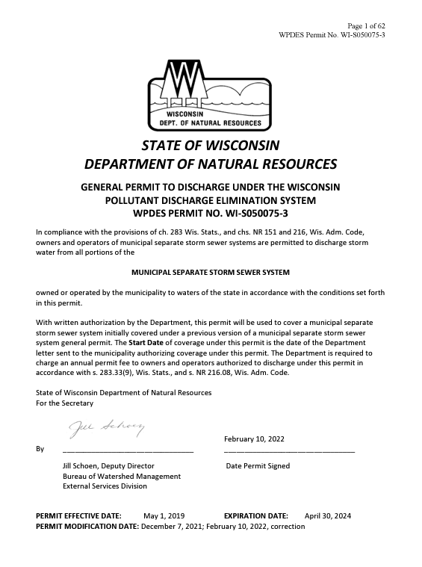
What is the MS4 Report?
MS4 stands for Municipal Separate Sewer System
General Permit for Municipalities
  Issued for a 5-yr permit term and renewed
  Requires the Town to create and manage a stormwater program
  Requires the Town to submit an Annual Report to the WI DNR showing compliance with the permit conditions

Slide 3
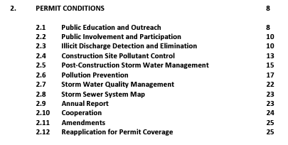
MS4 Permit Requirements
Notes:
Public Education – Required to educate on 8 topic areas (IDDE, Household Hazardous Waste/Pet Waste/Vehicle Washing, Yard Waste Management/Pesticide and Fertilizer Application, Steam and Shoreline Management, Residential Infiltration, Construction Sites and Post Construction Stormwater Management, Pollution Prevention, Green Infrastructure/Low Impact Development). Two Interactive Mechanisms and Two Passive Mechanisms per year.
Public Involvement – Provide one annually opportunity to provide input on annual report, stormwater management, adoption of stormwater ordinance.
IDDE – Ordinance, Field Screening, source investigation and elimination
Construction Site Pollutant Control – Ordinance, Plan Review, Site Inspections and enforcement
Post-Construction SWM – Ordinance, Plan Review, Long-term Maintenance and Inspections
Pollution Prevention – SWM Facilities, Municipally Owned public works facility, Street Sweeping, Catch Basin, Material Handling and Disposal , Winter Road Management, Internal Education
Stormwater Quality Management – Water Quality Model showing reduction in pollutants
Storm Sewer System Map – Identification of waters of the state, wetland , outfalls, municipally owned or operated stormwater management facilities, parks, open land, garages, streets

Slide 4
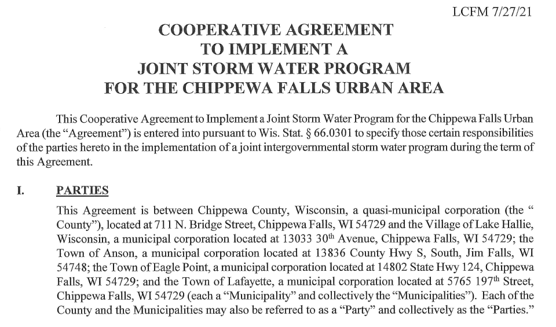
Meeting the Permit Requirements
Member of Rain to Rivers
Participates in MS4 group meetings
Contracted with Chippewa County to assist in fulfilling the permit
Provides all necessary information to submit an Annual Report

Slide 5
Public Education and Involvement (2024 Annual Report)
Public Education
  Interactive Mechanism
  Passive Mechanism
Public Involvement and Participation
  Stormwater Management Program
  Stormwater Related Ordinance
  Volunteer Opportunity

Slide 6
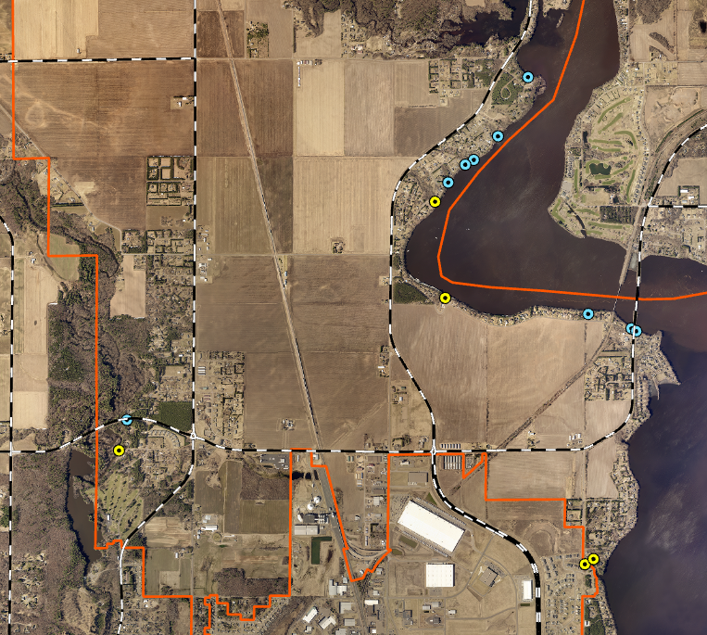
Illicit Discharge (2024 Annual Report)
Outfall Inspections
  14 Total Outfalls
    9 Minor Outfalls (Blue)
    5 Major Outfalls (Yellow)
  No contaminants detected
Notes:
Field Screening showed no signs of contaminants in the runoff. Test with a test strip.

Slide 7

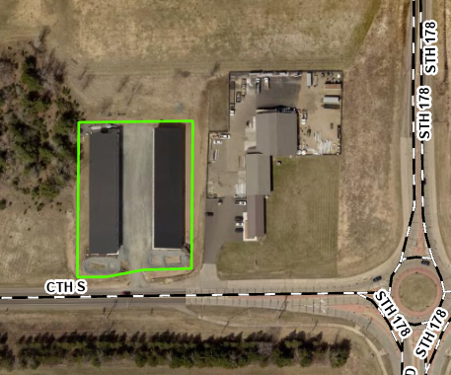
Construction Sites (2024 Annual Report)
One active construction site
  1 SW permit issued
  5 construction inspections completed in 2024

Slide 8
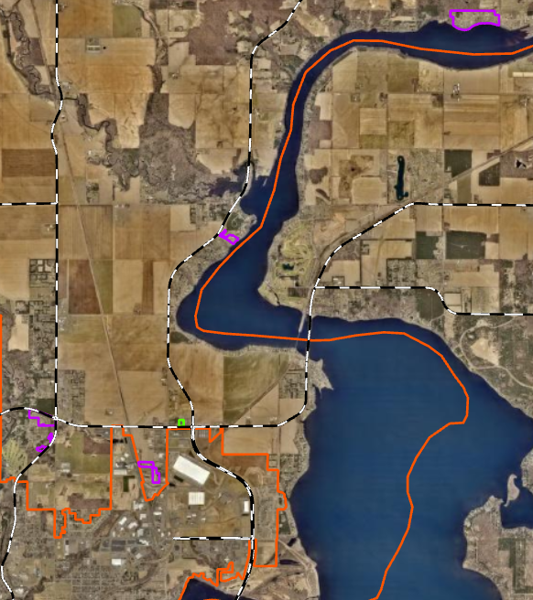
Post-Construction (2024 Annual Report)
10 privately owned post-construction stormwater facilities
  Annual inspections
  Reports are submitted to the Town

Slide 9

Pollution Prevention (2024 Annual Report)
Pollution Prevention
  Street Sweeping
  Leaf Collection Program
    Drop off at the Town’s Recycling Center
  Winter Road Management
    204 Lane Miles
    Salt and sand are spread
Notes:
The Town of Eagle Point is contracted with Chippewa County LCFM through a 66.03 Cooperative Agreement to inspect post-construction stormwater facility inspections.
The Town of Eagle Point has 6 post-construction facilities. The facilities are inspected annually and reports are submitted to the Town for review and enforcement.

Slide 10
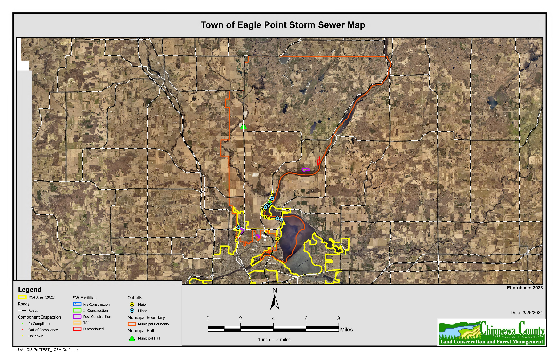
Storm Sewer Map (2024 Annual Report)
Notes:
Storm Sewer Maps are submitted to the WI DNR with all new and updated information.
Includes:
Outfall
Municipal Building
Construction Sites
Post-construction stormwater facilities
Catch basin
Urbanized Area

Slide 11
Fiscal Analysis (2024 Annual Report)
Reporting Area | Annual Expenditure (Reporting Year) | Budget (Reporting Year) | Budget (Upcoming Year)
Public Education and Outreach | $ 4,085.00 | $ 2,858.00 | $ 3,539.00
Public Involvement and Participation | $ 968.00 | $ 625.00 | $ 667.00
Illicit Discharge Detection and Elimination | $ 913.00 | $ 643.00 | $ 528.00
Construction Site Polluntant Control | $ 1,500.00 | $ - | $ 978.00
Post-Construction Stormwater Pollutant Control | $ 1,943.00 | $ 2,295.00 | $ 1,542.00
Pollution Prevention | $ 691.00 | $ 322.00 | $ 376.00
Storm Sewer Map | $ 830.00 | $ 720.00 | $ 672.00
Permit | $ 500.00 | $ 500.00 | $ 500.00
Notes:
Fiscal Analysis accounts for all the time and activities performed in each program area. Expenditures exceeded budget in 2024 but this is do to the audit work load and building stormwater management plans. It is not expected to remain at these levels in coming years but will be tracked.

